Slide 1
BANA-273 Term Project: Online News Popularity
Group 22: William Leonard, Susan Mikhail, Matthias Ronnau, Lokesh Nandni Sood, Parsa Tahmasebi

Slide 2

Agenda
Project Overview
The Data
Analysis
Results

Slide 3
Project Overview

Slide 4

Market Overview
Online News is:
Free
Immediate
Convenient
According to journalism.org:
25% of Americans get their news from News Websites or apps
18% check news on social media

Slide 5

Business Idea
Understand the different variables that contribute to the popularity of online articles
Help publishers create hit news pieces that receive many shares
Help social media platforms satisfy their customers’ needs
News articles can be customized according to its type and day of publishing to satisfy more news readers.
News article designers can improve the length and the word choices of their titles

Slide 6
Project Roadmap
Initial Question
What makes online articles popular?
Can we build a model to predict article popularity?
Data Wrangling
Examine the unprocessed data
Drop unnecessary columns
Analysis
Run Naïve Bayes, Random Forest, and KNN with/without preprocessing
Results
What features are important?
How can we increase shares?

Slide 7
The Data

Slide 8


The Data
Data Source:
UCI Machine Learning Repository
Mashable articles over two year period; “Online News Popularity”
About the Data:
61 variables:
58 for prediction,
2 for identification,
1 target variable (“shares”)
39644 Observations

Slide 9

The Data, Cont.
13 Binary variables: Weekdays & Data Channels
47 Continues variables: Number of images, number of videos, number of key words, etc.

Slide 10
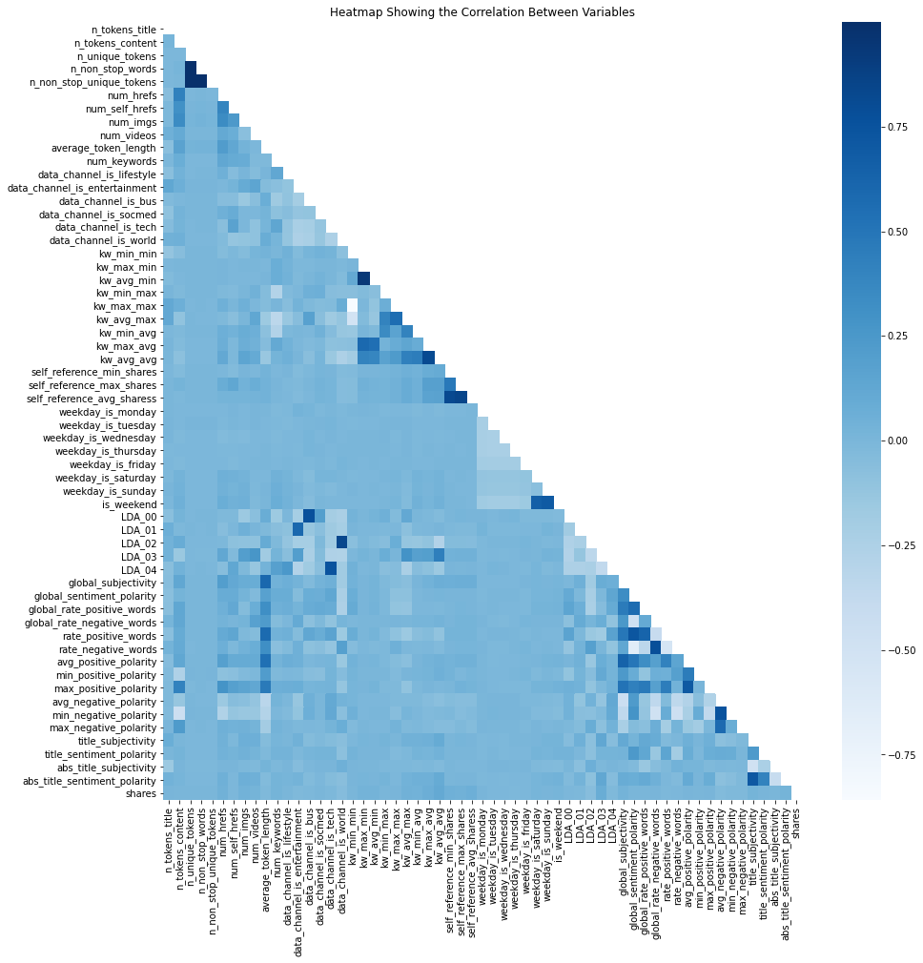
Exploratory Data Analysis
No missing values
Remove identification columns “url”, "timedelta"
Heatmap of correlation shows a few correlated variables
Remove these as a data processing step

Slide 11
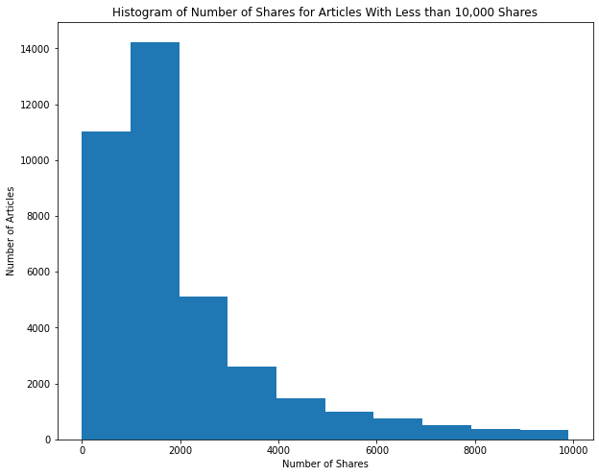
Exploratory Data Analysis, Cont.
Prediction variable “shares” is highly skewed right
Remove extreme values as a data processing step
Bin “shares” into Popularity “Low” and “High” based on median

Slide 12
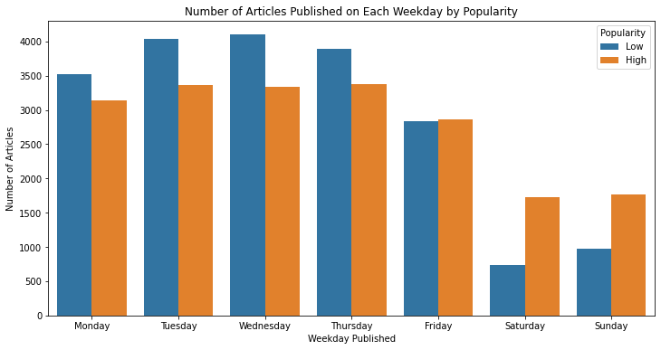
Exploratory Data Analysis, Cont.
Similar proportion of “Low” vs “High” popularity across weekdays, except on weekends

Slide 13
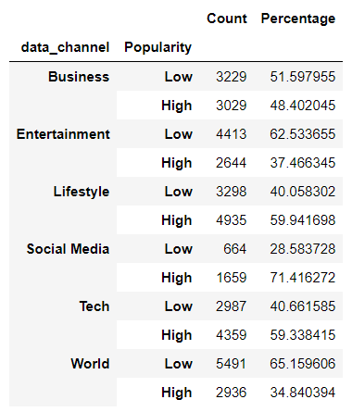
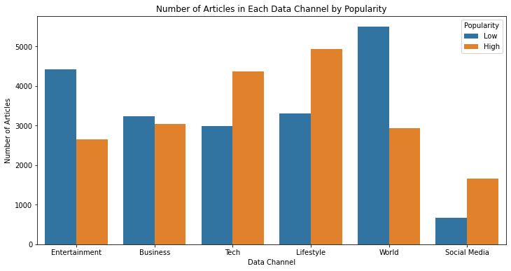
Exploratory Data Analysis, Cont.
“Lifestyle” articles have highest number of popular articles
“World” articles have highest number of unpopular articles
“Social Media” articles have highest percentage of popular articles

Slide 14
Analysis

Slide 15
Models and Pre-Processing
Models Used
Naïve Bayes
Random Forest
K Nearest Neighbors
Remove highly correlated variables
Remove data where articles had no words
Remove data where the number of shares was an outlier
Feature selection using mutual information
Supervised Binning
Omnibus Processing

Slide 16
Data Processing
Remove highly correlated variables:
Remove news articles that have zero words
Remove articles that have more than 2500 shares
Feature selection based on mutual information with “Popularity”
Supervised binning
Omnibus data processing

Slide 17

Naïve Bayes
Benchmark: 60.40%
Drop Correlated Columns: 60.40%
Drop No Words: 60.77%
Drop Extreme Shares: 61.18%
Feature Selection: 55.53%
Supervised Discretization: 64.73%
Omnibus: 56.47%

Slide 18
Random Forest
Benchmark: 63.92%
Drop Correlated Columns: 63.92%
Drop No Words: 64.04%
Drop Extreme Shares: 61.76%
Feature Selection: 61.77%
Supervised Discretization: 64.91%
Omnibus: 60.27%

Slide 19
K-Nearest Neighbors
Benchmark: 62.13%
Drop Correlated Columns: 62.13%
Drop No Words: 62.14%
Drop Extreme Shares: 59.15%
Feature Selection: 61.42%
Supervised Discretization: 62.55%
Omnibus: 57.84%

Slide 20
Results

Slide 21
Results
Results don’t improve much
Data already processed?
Random Forest was best overall
Random Forest with supervised discretization performed best
Some data processing reduced the accuracy

Slide 22
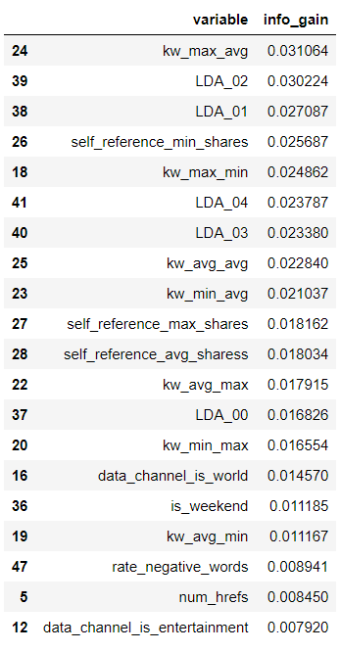
Results, Cont.
Low mutual information gain amongst any variable
No strong correlation amongst variables with “shares”
Focus on LDA Topics 1 and 2
Publish more social media articles, these are most popular by percentage

Slide 23
Thank You!

